Slide 1
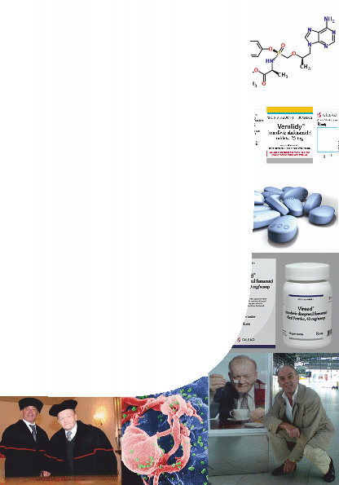


University of South Bohemia in České Budějovice
&
Biology Centre, Czech Academy of
Sciences
are inviting you cordially to attend the lecture given by the most esteemed guest:
Professor Erik De Clercq, D.M., Ph.D.
(Rega Institute for Medical Research, Catholic University, Leuven, Belgium; visiting Professor and Doctor honoris causa of the University of South Bohemia; lifelong workmate and friend of Prof. Antonín Holý , both having the outstanding merit achieved in modern antiviral research)
TAF (Tenofovir alafenamide), the successor of TDF (Tenofovir disoproxil fumarate)
on Wednesday February 1st, 2017 at 10:00AM
in the seminar room at the Institute of
Parasitology (PARU II)
Contact: Libor Grubhoffer
(5456, liborex@paru.cas.cz)

